Slide 1
Super Store
Sales Analysis

Slide 2
INTRODUCTION
Myself, Aakash Dharshan.
Here I am going to present the Sales Tracking of the Super Market across different Sectors, Products, Shipment Details, Region and Category via Data Visualization.

Slide 3
CONTENTS
01
UNIVARIATE ANALYSIS
02
BIVARIATE ANALYSIS
03
MULTIVARIATE ANALYSIS
04
CONCLUSION

Slide 4
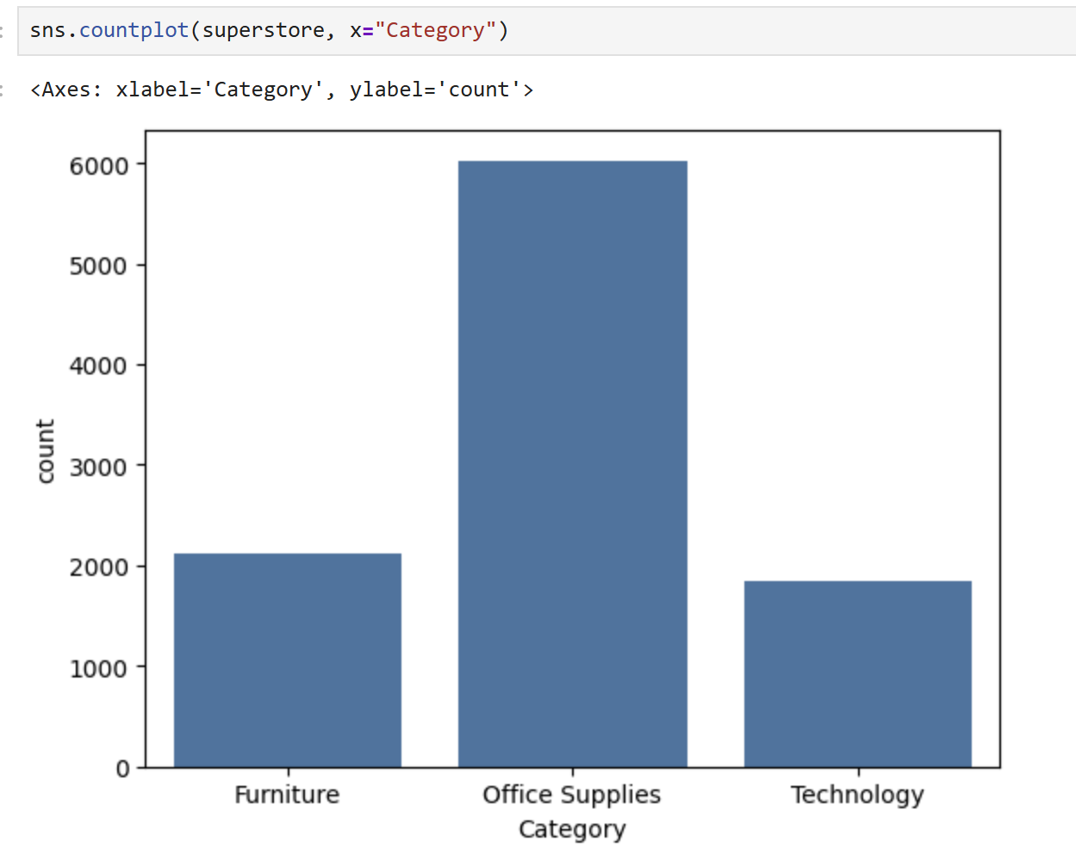
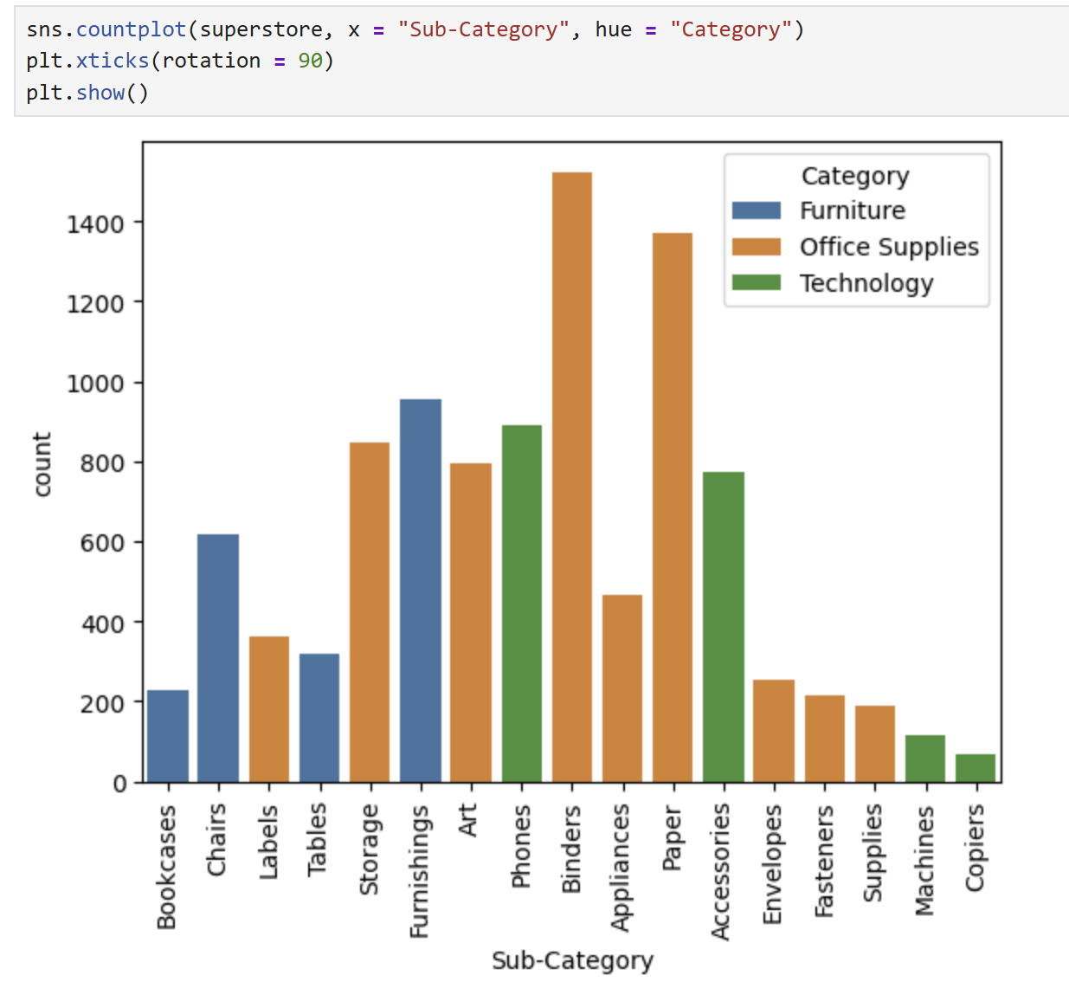
Category Distribution Analysis
Insights:
1) Office Supplies category has the highest number of orders.
2) Furniture and Technology categories have comparatively fewer orders.
3) In sub-categories, Binders and Paper have the highest counts.
4) Phones and Furnishings are also frequently purchased products.
5) Machines and Copiers have the lowest order frequency.
6) Customers mostly purchase low-cost office-related products regularly.

Slide 5
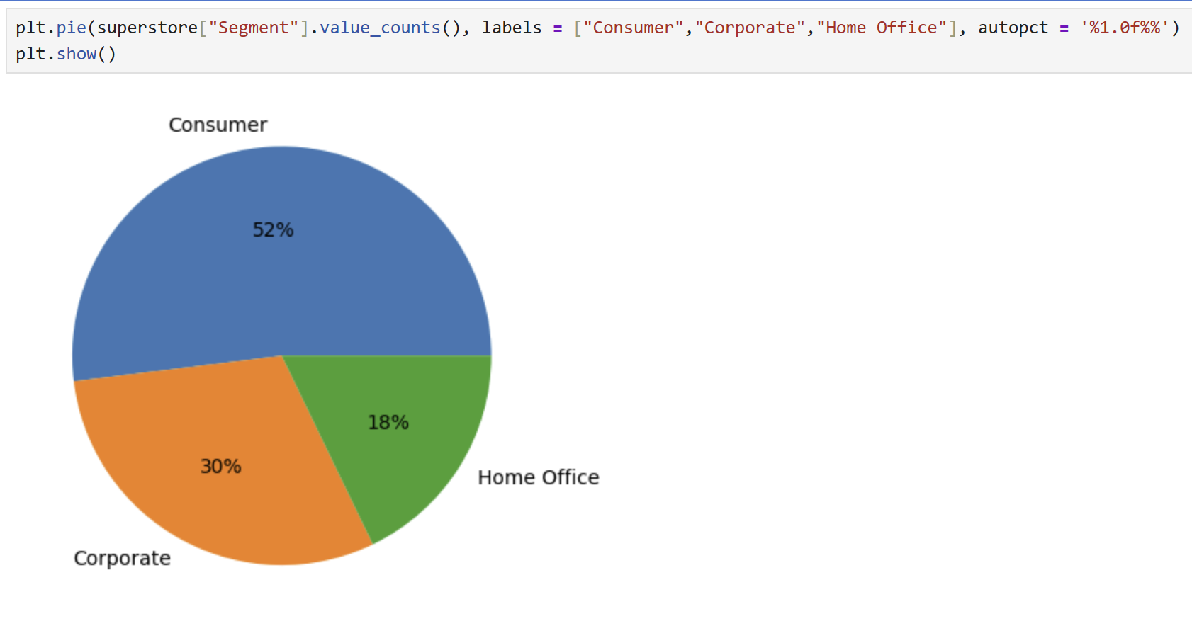
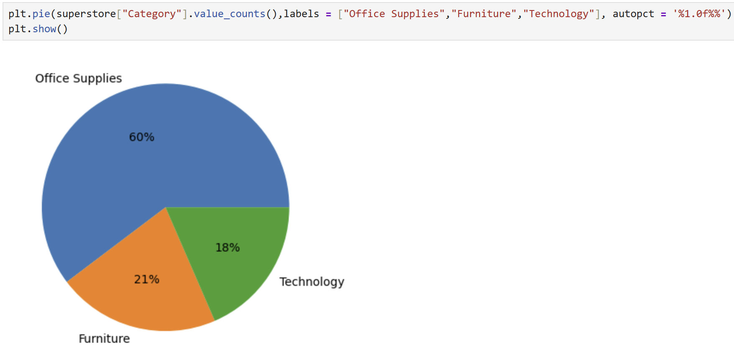
Category Distribution Analysis
Insights:
Consumer segment contributes the highest share of orders (around 52%).
Corporate segment contributes moderate sales/orders (around 30%).
Home Office segment has the lowest contribution (around 18%).
Office Supplies category dominates overall orders (around 60%).
Furniture and Technology categories contribute smaller shares.
Customers purchase office-related products more frequently than technology products.

Slide 6
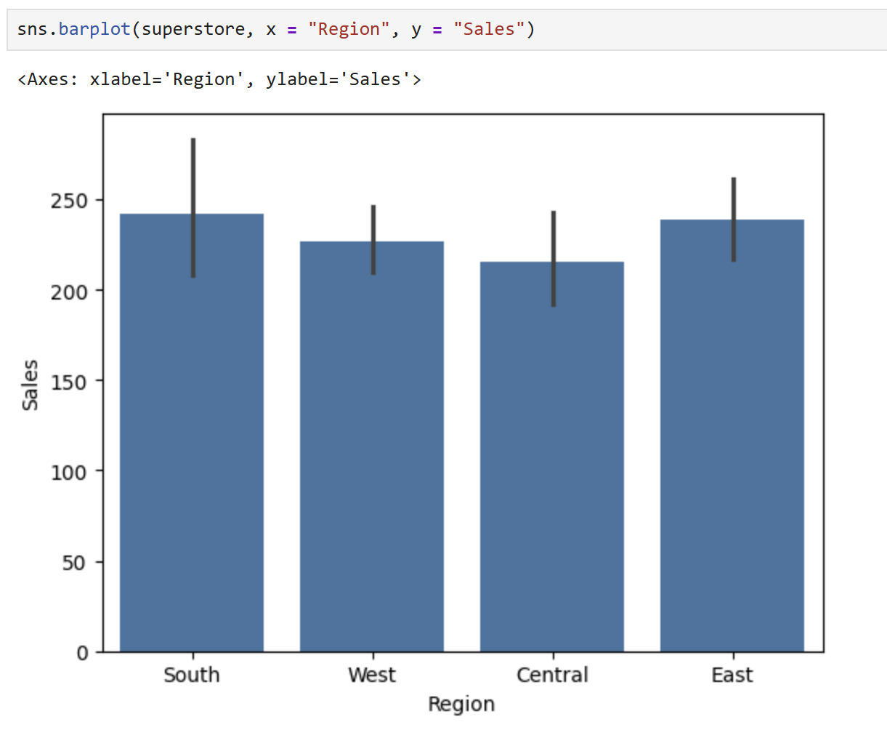
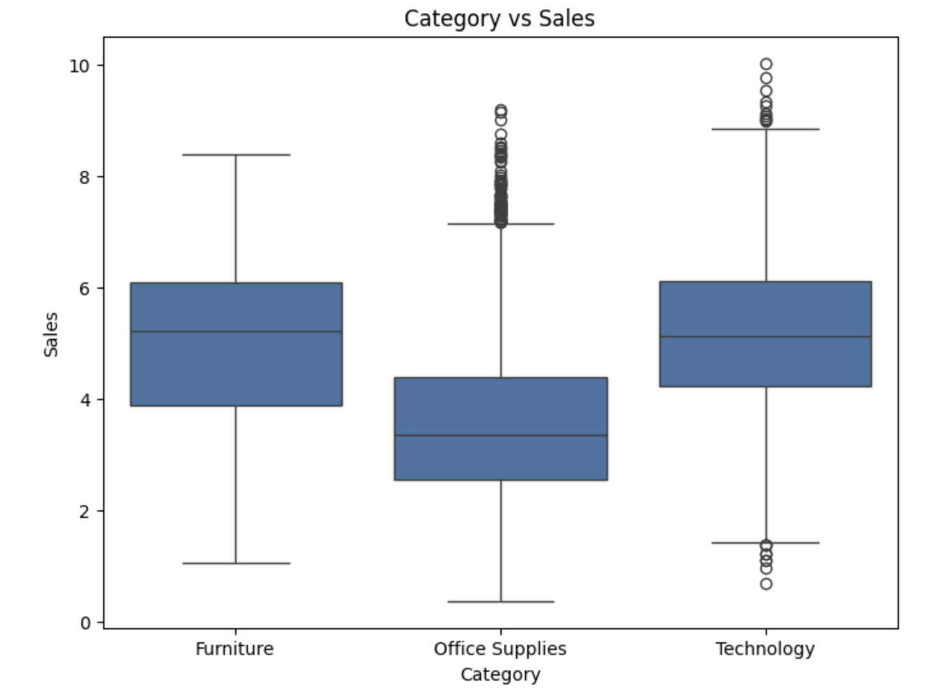
Bivariate Analysis
South and East regions show higher average sales.
Technology category has highest sales variability.
Office Supplies has lower median sales.
Presence of outliers indicates high-value transactions.

Slide 7
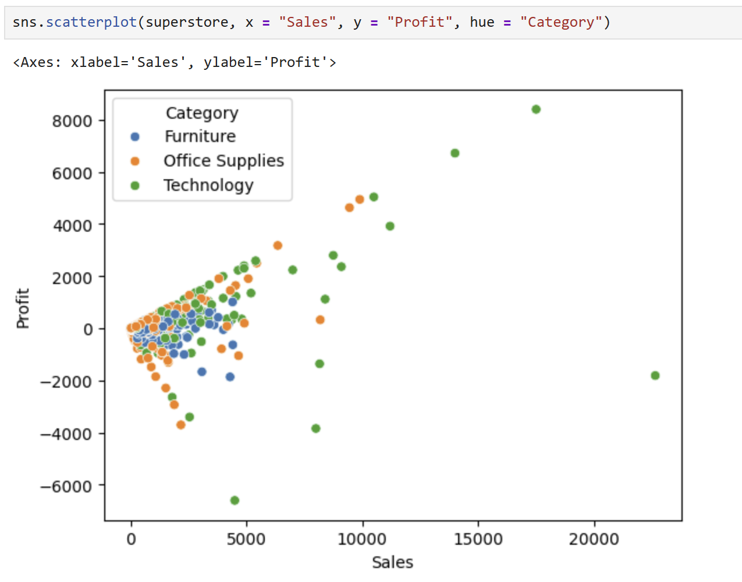
MULTIVARIATE ANALYSIS
Category-wise Profit Distribution
Sales and Profit show a positive relationship.
Higher sales generally lead to higher profit.
Some transactions result in negative profit despite high sales.
Technology category has the highest profit variability.
Presence of outliers indicates high-value transactions

Slide 8
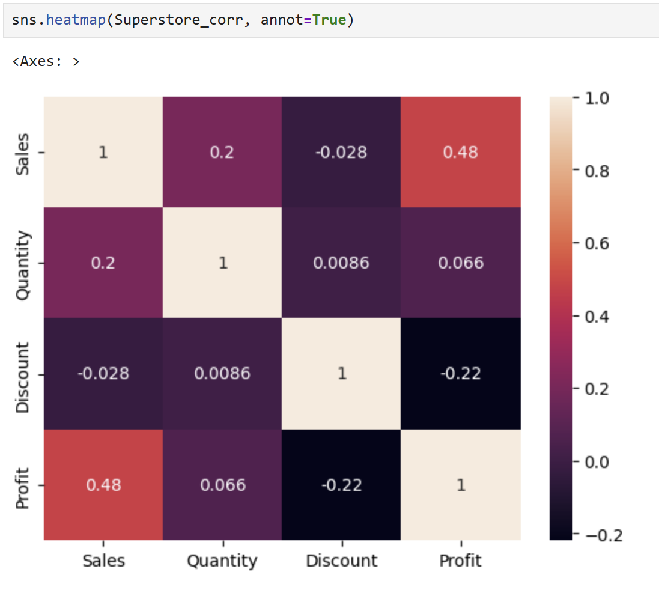
CORRELATION ANALYSIS
1,000
POINT 02
10,000
Sales and Profit show moderate positive correlation (0.48).
Discount and Profit have negative correlation (-0.22).
Higher discounts may reduce profitability.
Quantity has very weak correlation with Profit.
Sales slightly increase with Quantity.
POINT 01
1,000,000
100,000
POINT 04
POINT 03

Slide 9
CONCLUSION
Office Supplies category has the highest number of orders.
Technology category generates high-value sales and profits.
Sales and Profit show a positive relationship overall.
Some transactions result in negative profit despite high sales.
Discount has a negative impact on Profitability.
High-value outliers are present across categories.
Consumer segment contributes the highest share of sales.
East and South regions show comparatively better sales performance.
Quantity has only a weak relationship with Profit.
Data visualization helped identify trends, outliers, and business patterns effectively.

Slide 10
"SUCCESS IS NOT THE KEY TO HAPPINESS. HAPPINESS IS THE KEY TO SUCCESS. IF YOU LOVE WHAT YOU ARE DOING, YOU WILL BE SUCCESSFUL."
ALBERT SCHWEITZER

Slide 11
Thank You !

